Slide 1
Logic circuits Exercise 2.8
Danicico George-Iulian
Group 912

Slide 2
Exercise 2.8
For each of the following Boolean functions draw the corresponding logic circuit using derived gates, simplify the function and draw the logic circuits associated to all simplified forms of the initial function using only basic gates.
f8(x, y, z) =x( ̄y ↑ z) V ̄x( ̄y ⊕ z) V y(x⊕ ̄z)

Slide 3
Steps:
Draw the corresponding logic circuit using derived gates.
Draw the table of values and determine the support of function f8.
Determine the minterms of the function and the DCF.
Simplify using Karnaugh's method.

Slide 4
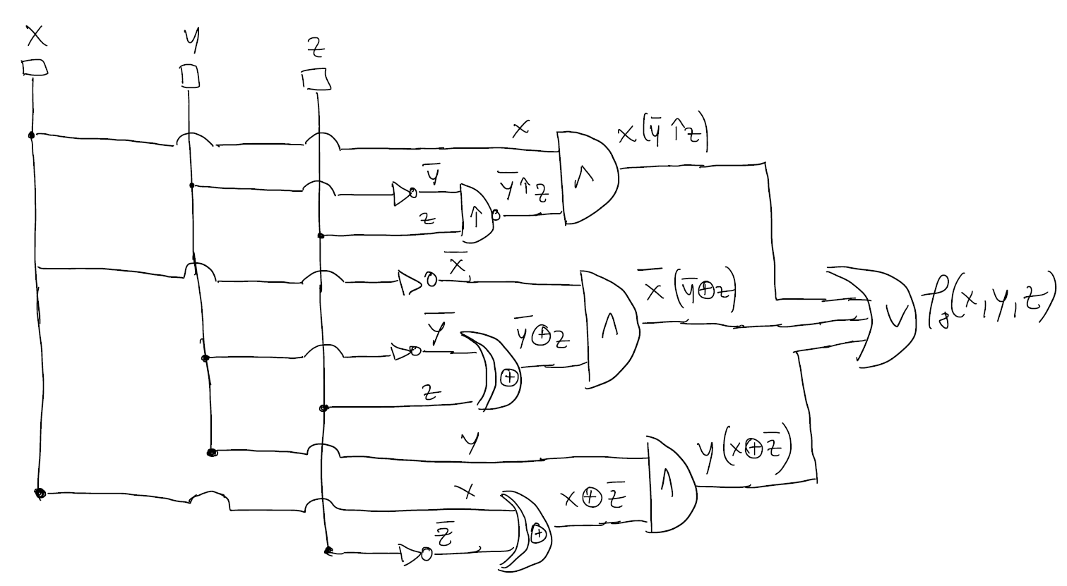
Step 1. Draw the corresponding logic circuit using derived gates
f8(x, y, z) =x( ̄y ↑ z) V ̄x( ̄y ⊕ z) V y(x⊕ ̄z)

Slide 5
Step 2.Draw the table of values and determine the support of function f8.
f8(x, y, z) =x( ̄y ↑ z) V ̄x( ̄y ⊕ z) V y(x⊕ ̄z)
x | y | z | ̄y ↑z | ̄y ⊕z | x⊕ ̄z | x( ̄y↑ z) | ̄x( ̄y ⊕ z) | y(x⊕ ̄z) | f8(x, y, z)
0 | 0 | 0 | 1 | 1 | 1 | 0 | 1 | 0 | 1
0 | 0 | 1 | 0 | 0 | 0 | 0 | 0 | 0 | 0
0 | 1 | 0 | 1 | 0 | 1 | 0 | 0 | 1 | 1
0 | 1 | 1 | 1 | 1 | 0 | 0 | 1 | 0 | 1
1 | 0 | 0 | 1 | 1 | 0 | 1 | 0 | 0 | 1
1 | 0 | 1 | 0 | 0 | 1 | 0 | 0 | 0 | 0
1 | 1 | 0 | 1 | 0 | 0 | 1 | 0 | 0 | 1
1 | 1 | 1 | 1 | 1 | 1 | 0 | 0 | 1 | 1
Step 3. Determine the minterms of the function and the DCF.
DCF(f) = m0 V m2 V m3 V m4 V m6 V m7
DCF(f) = ̅x ̅y ̅z V ̅xy̅z V ̅xyz V x̅y ̅z V xy̅z V xyz

Slide 6
Step 4. Simplify using Karnaugh's method.
x \ yz | 00​ | 01​ | 11 | 10
0​ | m0​ | ​ | ​m3 | m2
1​ | m4​ |  | m7 | m6
Factorization process
max1 = m0 V m2 V m4 V m6 = ̄z
max2 = m2 V m3 V m6 V m7 = y
The set of maximal monoms: M(f) = {max1, max 2}
Because both max1 and max2 have at least one minterm circled only once, they are central monoms => C(f) = {max1, max2}.

Slide 7
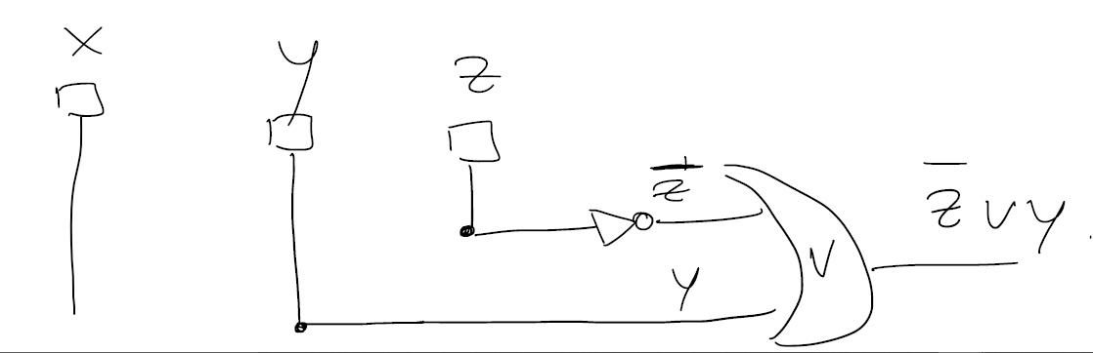
M(f) = C(f) --- the first case of the simplification algorithm => There is a unique simplified form of f, obtained as the disjunction of all central monoms.
f8(x, y, z) = max1 V max2 = ̄z V y

Slide 8

Thank you for your attention!

